Slide 1
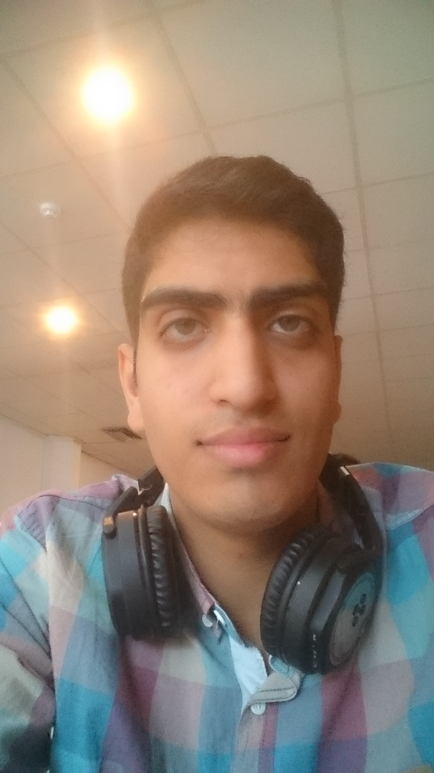
Mohammad Sabouri
Master student of Genova University in field of Robotic Engineering.
Master's Degree in Electrical-Control Engineering, Shiraz University, Shiraz, Iran.
Laurea Magistrale in Ingegneria dell'Elettrocontrollo, Università di Shiraz, Shiraz, Iran.

Slide 2
EDUCATION
Master of Science in Control Engineering.
Modelling and control of non-holonomic mobile robots using the quasi-LPV method.
Bachelor of Science in Electrical Engineering, with a specialty in Control.
Design and implementation of sound compass for trajectory control of mobile robot.
Diploma:
Diploma in Industrial Electricity Discipline.
Diploma in Mathematics and Physics Discipline.

Slide 3
PUBLICATIONS
1-Sabouri, Mohammad, and Mohammad Hassan Asemani. "LPV Controller Design for Trajectory Tracking of Non-holonomic Wheeled Mobile Robots in the Presence of Slip."202129th Iranian Conference on Electrical Engineering (ICEE).IEEE.(2021,October).
2-Shayan, Z.,Sabouri, M., Shayan, M., Asemani, M. H., Sarmoori, A. B., & Zare, M.,
“Pressure Control of Cellular Electromechanical Medical Mattress For BedsorePrevention,”7th International Conference on Control, Instrumentation and Automation (ICCIA),IEEE. (2021, February).
3-Firouzimagham, D., Aminaie, P., Shayan, Z.,Sabouri, M., & Asemani, M. H., “Online Transformer Oil Analysis Based on Spectroscopy Technique and Machine Learning Classifier: Experimental Setup,”15th International Conference on Protection and Automation of Power Systems (IPAPS). IEEE. 2020.
4-M. Sabouri,P. Setoodeh, M.H. Asemani, ''Construction of Lyapunov Functions using Multi-Objective Genetic Algorithm'',28thIranian Conference on Electrical Engineering (ICEE), Tabriz University,2020,Tabriz, Iran.
5-M. Zare, M. Jampour, A.S. Arezoomand,M. Sabouri, “Handwritten Recognition basedon Hand Gesture Recognition using Deterministic Finite Automata and Fuzzy Logic,” 4th International Conference on Pattern Recognition and ImageAnalysis(IPRIA), 2019, Tehran, Iran. IEEE.

Slide 4
PUBLICATION (Under working)
‘’The Design of a Cuff Electrode for Long Term Neural Signal Recording with Selective Recording Capability to Rehabilitate People with Nerve Damage’’ August 2022- International Journal of Innovative Science and Research Technology ISSN No:2456-2165
‘New Energies in Sustainable Architecture’’ February 2022- 6th International Conference on Researches in Science & Engineering & 3rd.International Congress on Civil, Architecture and Urbanism in Asia – Kasim Bundit University,Thiland

Slide 5
Professional Experience (1)
Work Experiences:
Robotic Research at Minoosa company.
Research Assistant at Applied Control & Robotics Research Laboratory(ACRRL).
Mechatronics Department Manager at “Arioobarzan” company.
Designer engineer at “Kasbo Kar Jahan Jadid” company.

Slide 6
Professional Experience (2)
Teaching Experiences:
Teacher Assistant:
Computer Applications in Control (LabVIEW and Matlab), Shiraz University.
Multi Input Multi Output Control, Shiraz University.
Modern Control, Shiraz University.

Slide 7
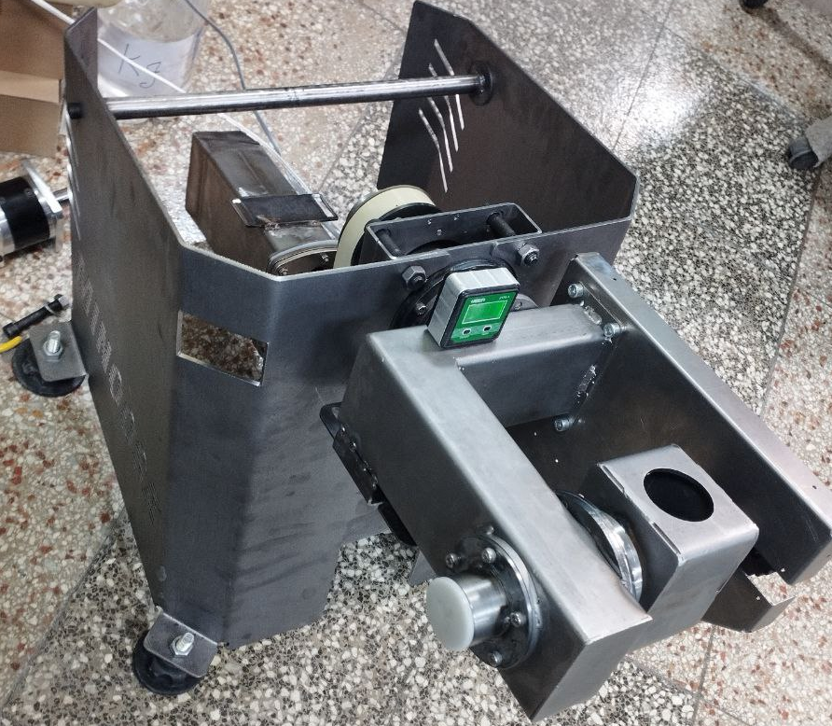
RESEARCH EXPERIENCES
Research Projects:
0- Design and Implementation controller algorithm for 3 DOF special manipulator for robotic fountain.

Slide 8
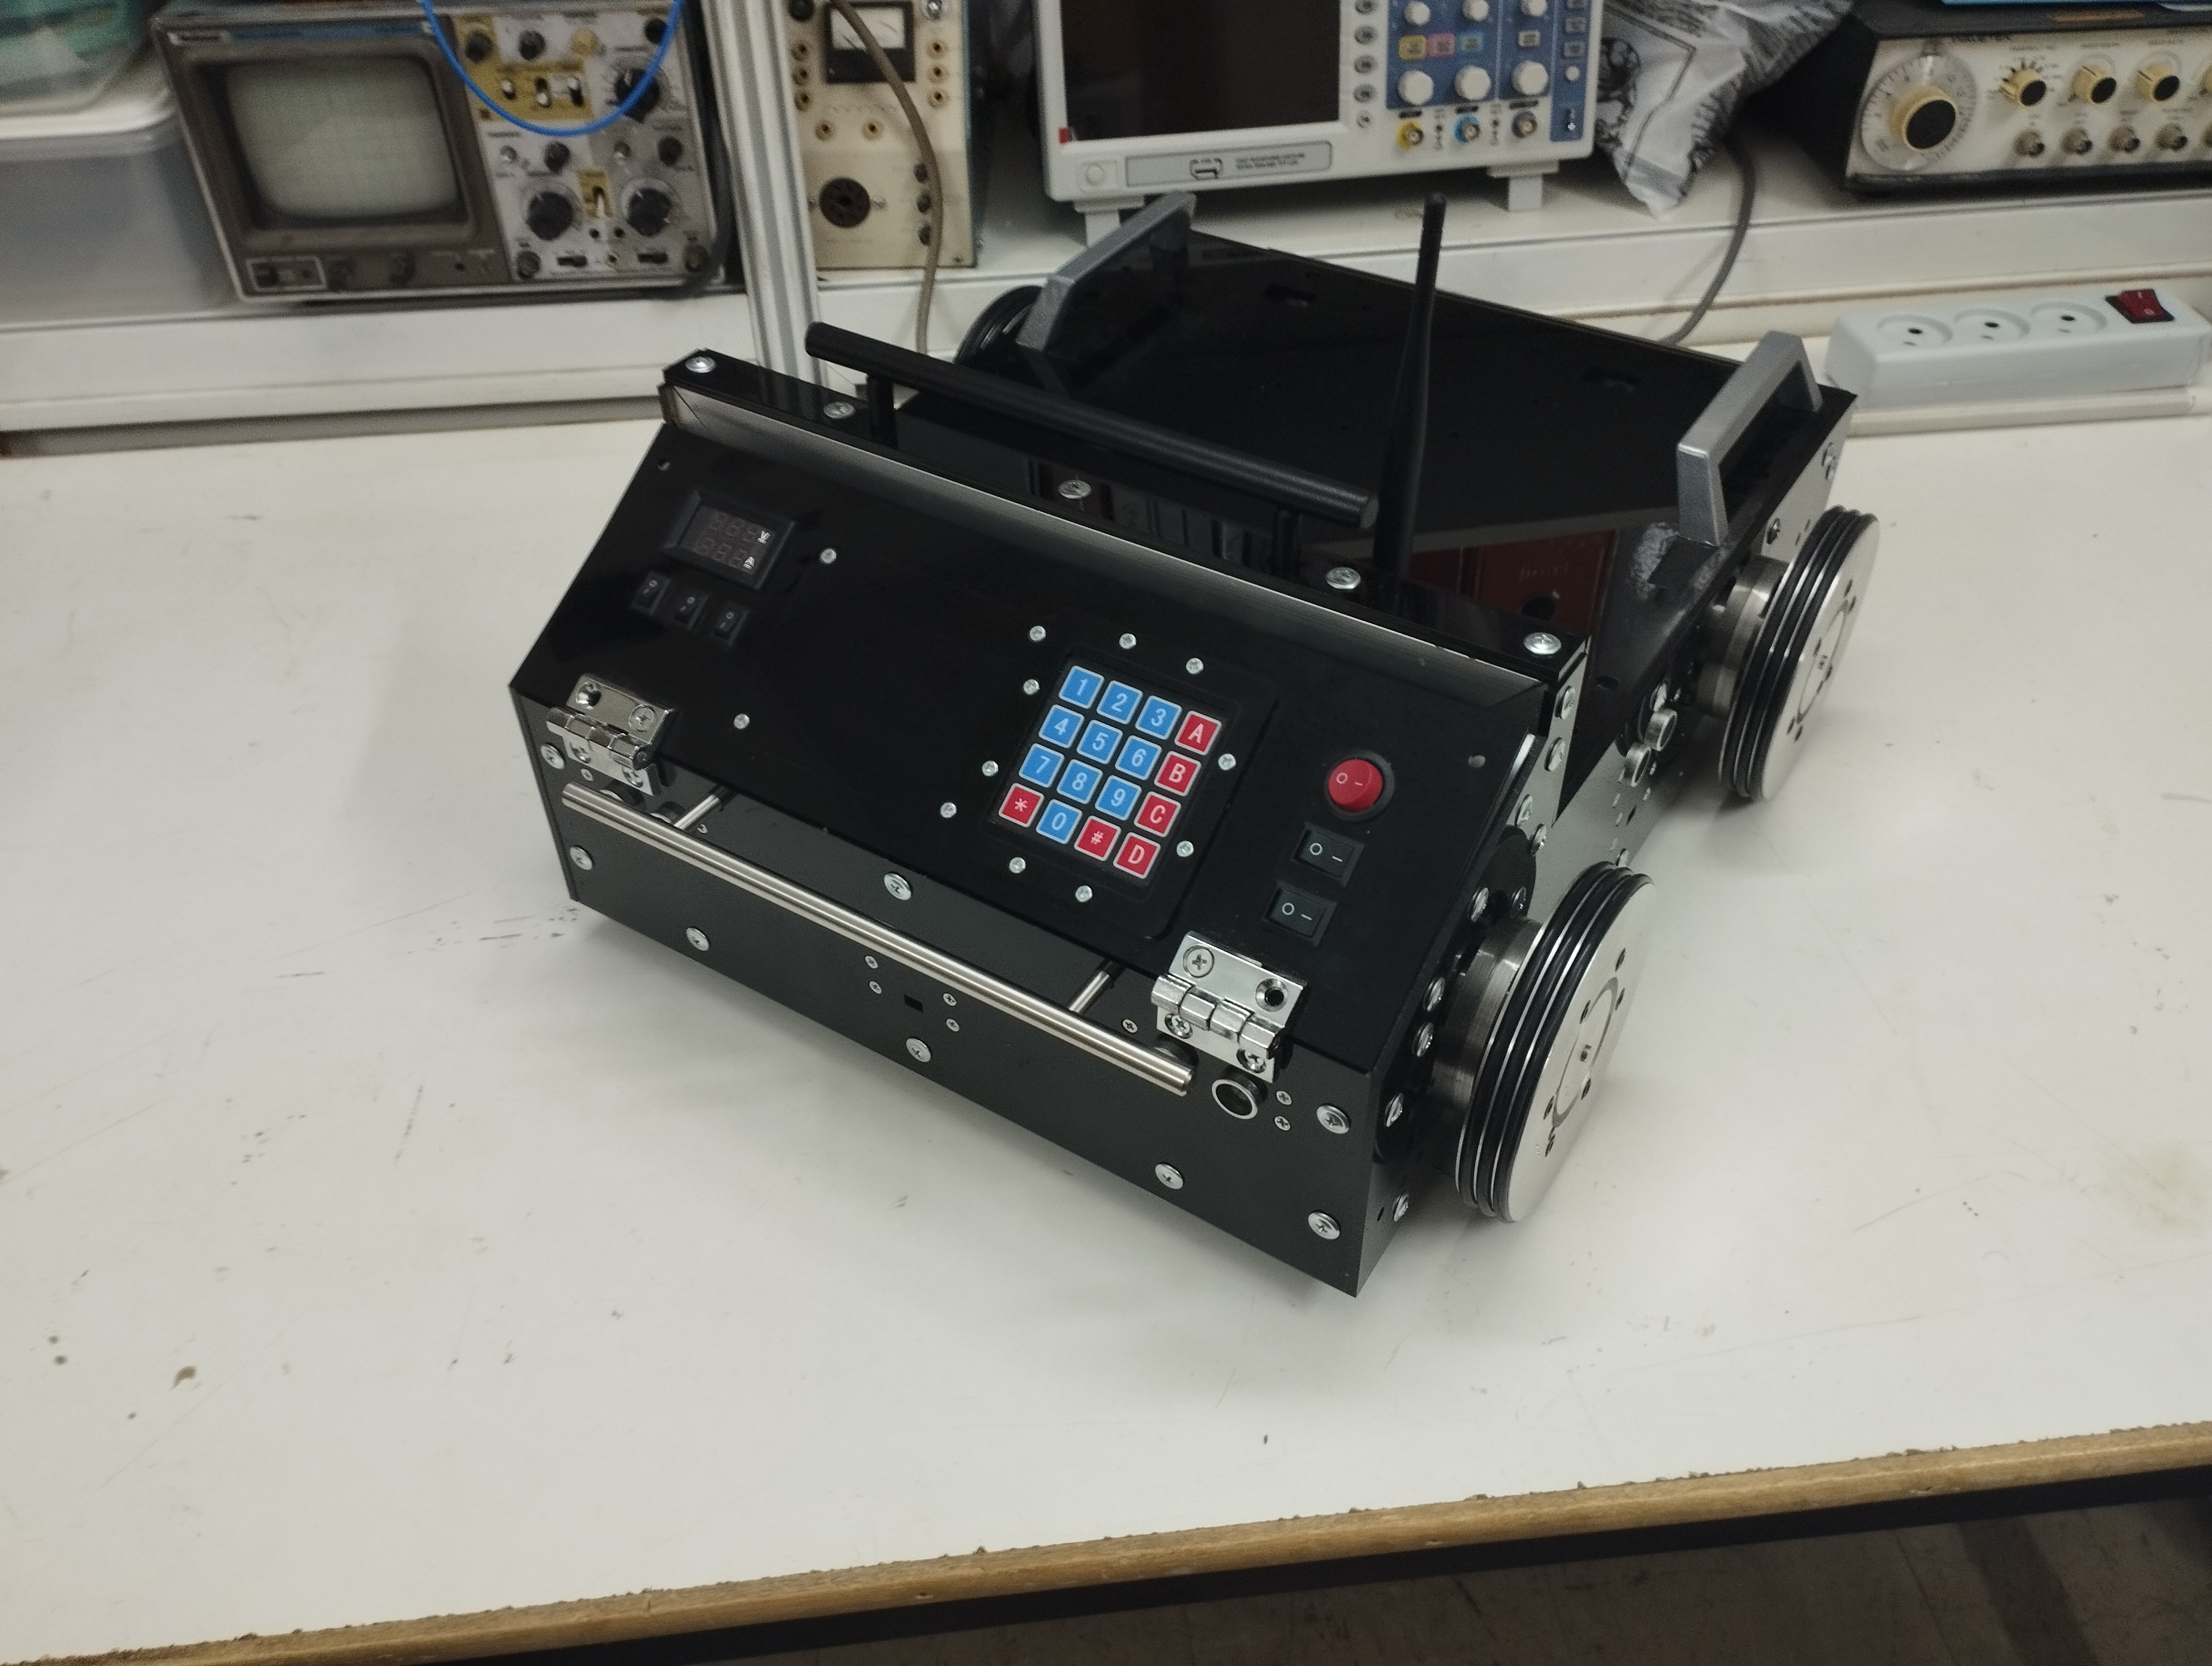
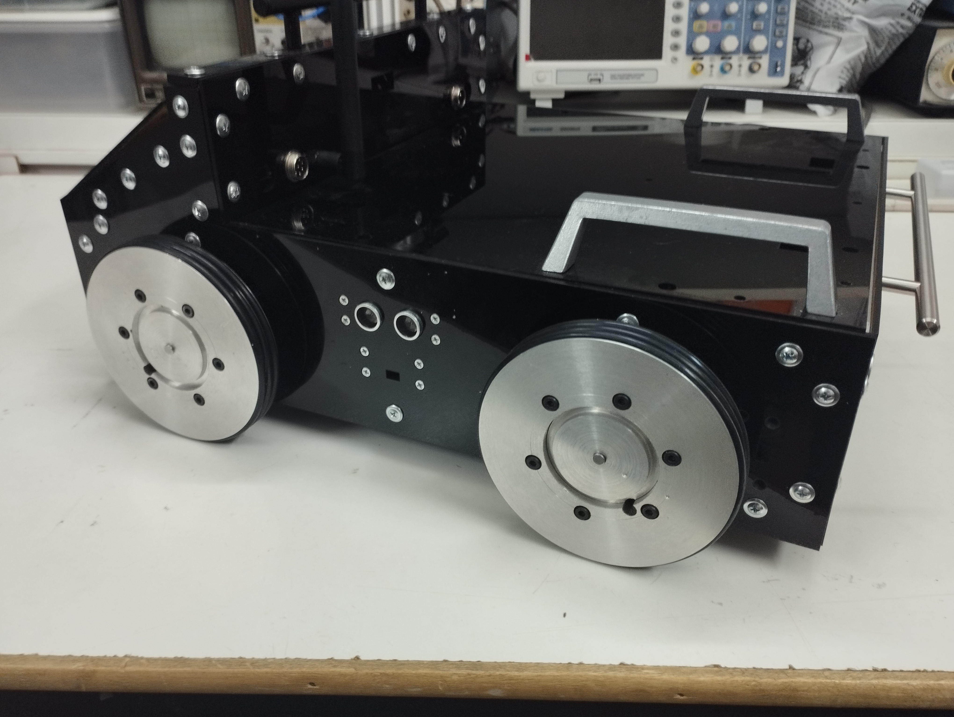
RESEARCH EXPERIENCES
Research Projects:
1- Design and Implementation Non-holonomic Mobile Robot.

Slide 9
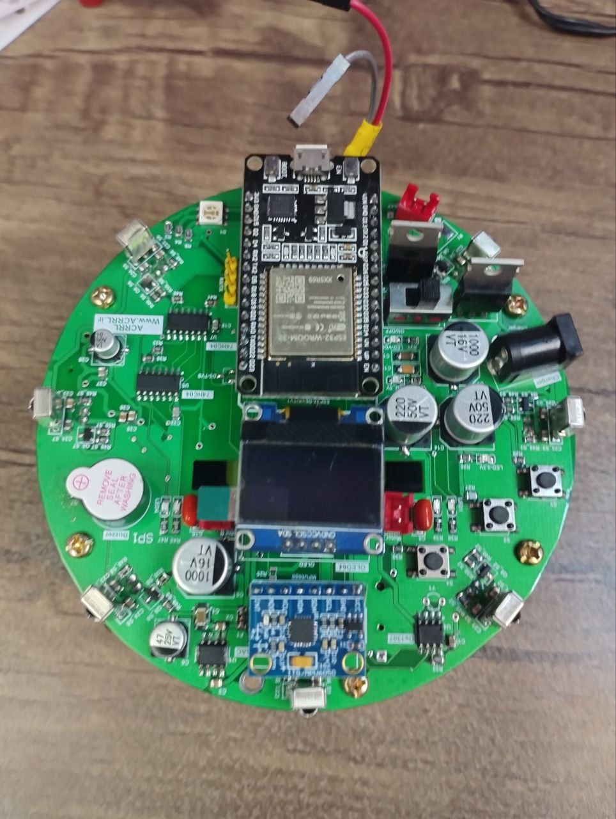
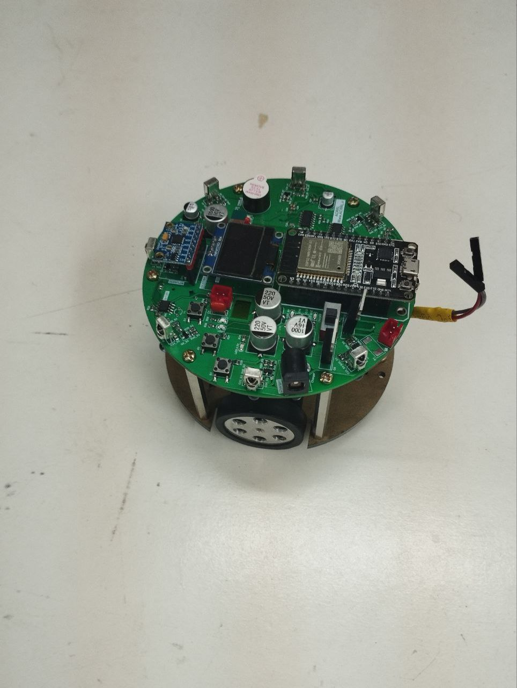
RESEARCH EXPERIENCES
Research Projects:
2- Design and Implementation Differential Mini-Mobile robot for Swarm applications.

Slide 10
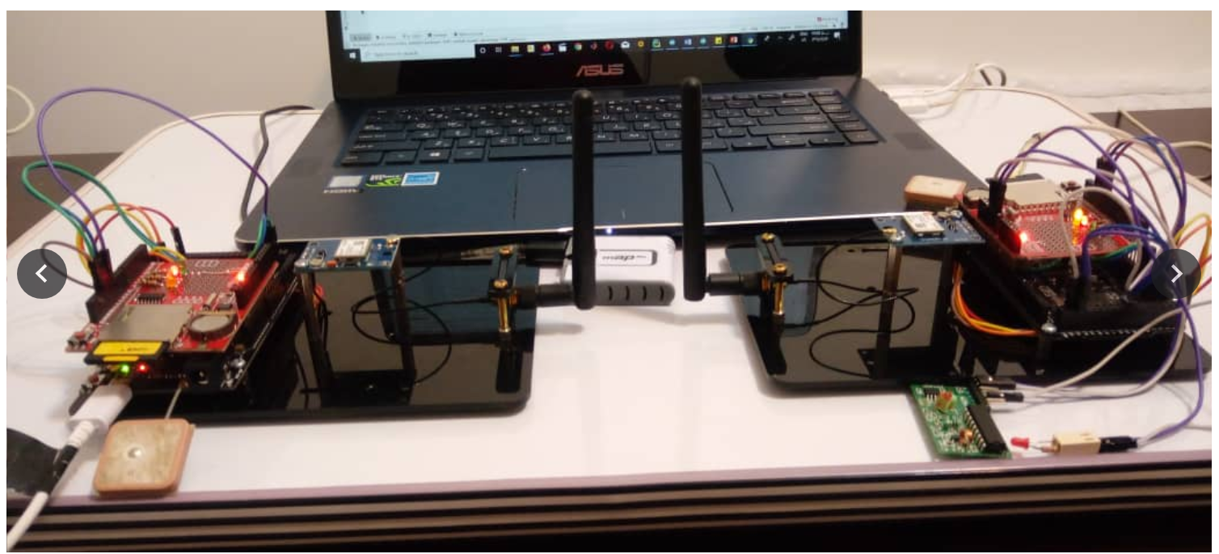
RESEARCH EXPERIENCES
Research Projects:
4- Manufacturing a hardware simulator to synchronize PMU data and send it to the control center.

Slide 11
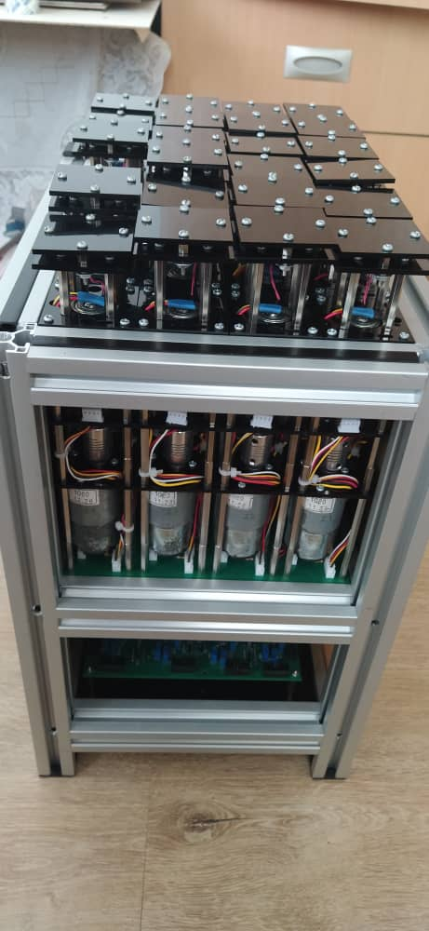
RESEARCH EXPERIENCES
Research Projects:
5- Bedsore prevention Bed. Design, Implementation and Control.

Slide 12
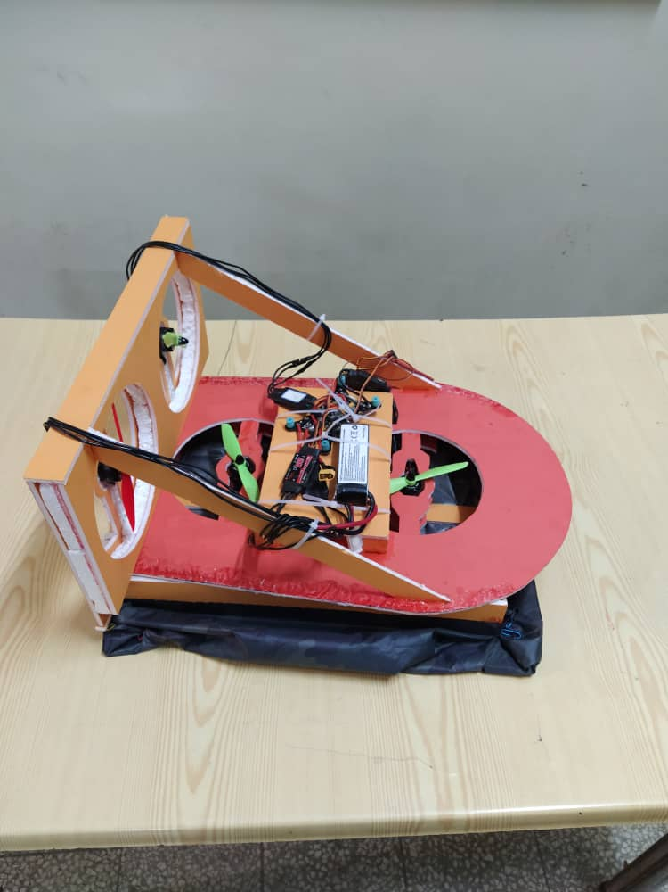
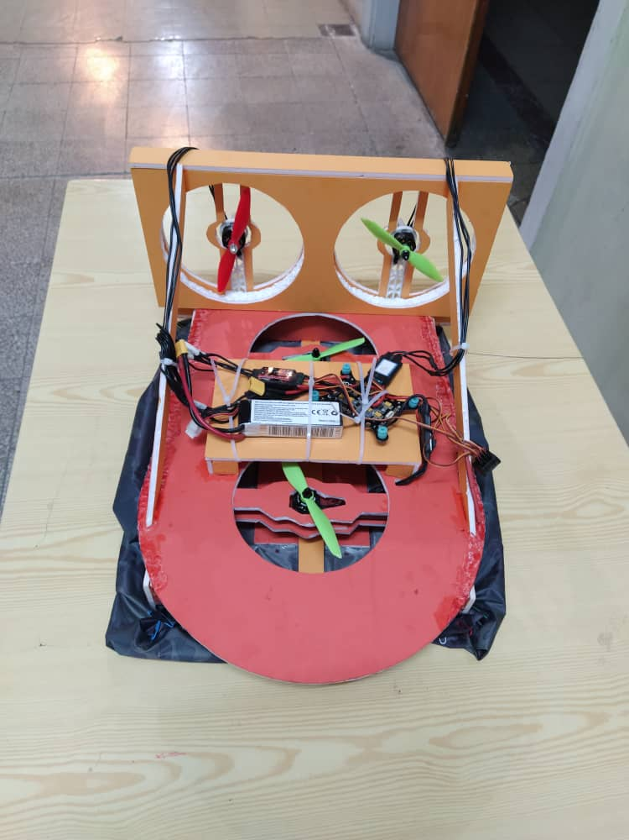
RESEARCH EXPERIENCES
Research Projects:
5- Patch planning and control the movement of Hovercraft. (re modeling the dynamic and kinematic with LPV method and design LPV Controller by LMI techniques.

Slide 13
RESEARCH EXPERIENCES
Interested Research Projects:
5- Design and construction of smart medical beds to prevent bedsores with the ability to receive feedback from the patient's condition.
6- Transformer Oil Quality Assessment System Based on Internet of Things in PowerGrid.
7- Design Fibrinogen Prediction System Based on Artificial Neural Network.
8- Design and Implementation of Dry Medical Block Heater.

Slide 14
PROFESSIONAL SKILLS
Programming Languages: C, C++, Python, PLC Programming.
Technical Robotic Software: Ros1 and Ros2, CoppeliaSim.
Technical Software: MATLAB, LabVIEW, Altium Designer, Proteus, Solid Work.
Operation Systems: Windows, Linux.
Public Software: Microsoft Office, Latex, Edraw, Visio, Endnote, Mendeley.
Web/Server-side Programming: HTML, CSS, Php.

Slide 15
EXTRA TRAINING
Altium Designer Software, Educational institution in Shiraz, Summer2019.
AVR microcontrollers, Educational institution in Shiraz, Summer2017.
Robotic teaching certificate,NURMS,Feb.2017.
Designer and analyst of AVR microcontrollers, Iran Technical and Vocational Training Organization, Jun.2017.
Entrepreneurship with the KAB method, Iran Technical and Vocational Training Organization, Jun.2017.
Installer of Intelligent Building Management System (BMS),Iran Technical and Vocational Training Organization,Nov.2016.
Assembly and installation of electrical panels, Iran Technical and VocationalTraining Organization,Sep.2016.
ICDL 2, Iran Technical and Vocational Training Organization,Sep.2016.
Industrial grade 2 electrical power, Iran Technical and Vocational TrainingOrganization,July2016.
Robotic Programming, Iran Technical and Vocational Training Organization,Oct.2014.
Basics of Robotic Concept, Iran Technical and Vocational Training Organization, Oct.2014.
Robotic Hardware, Iran Technical and Vocational Training Organization,Sep.2014.
MATLAB, South Industrial Management Institute(SIMI),Summer2013.

Slide 16
LANGUAGE SKILLS
English
Persian

Slide 17
AWARDS AND PRIZES
1st Place Gladiators Warrior Robot League, RoboSkill Competition under the Supervision of Kerman Technical and Vocational Training Organization, Aug. 2016.
Third place in 30 kg Warrior Robot League, RoboSkill Competition under the super vision of Kerman Technical and Vocational Training Organization, Aug. 2016.
Diploma of Honor In 15th National Skill Competitions in the field of robotics, Iran Technical and Vocational Training Organization, Karaj, Iran, Aug. 2014.
First place in National Skill Competitions, the provincial stage in the field of robotics, Iran Technical and Vocational Training Organization, Fars, Iran, Jun. 2014.
Second place in National Skill Competitions, the provincial stage in the field of robotics, Iran Technical and Vocational Training Organization, Fars, Iran, Jun. 2013.

Slide 18
Thank you for your consideration

